Slide 1
Emma Donoghue
Room
ENG 527
By Jacquelyn McGlinchey
4-9-2014

Slide 2
Room
First, let’s start off with a link to the website for Room.
http://www.roomthebook.com/
A few clicks and you enter Room– Ma and Jack’s world.
I know when I was reading the book, Room was a lot bigger in my head. How did you envision Room?
Scroll and click on the different objects in Room for in-depth information about Room and Emma Donoghue (and to hear Jack).

Slide 3
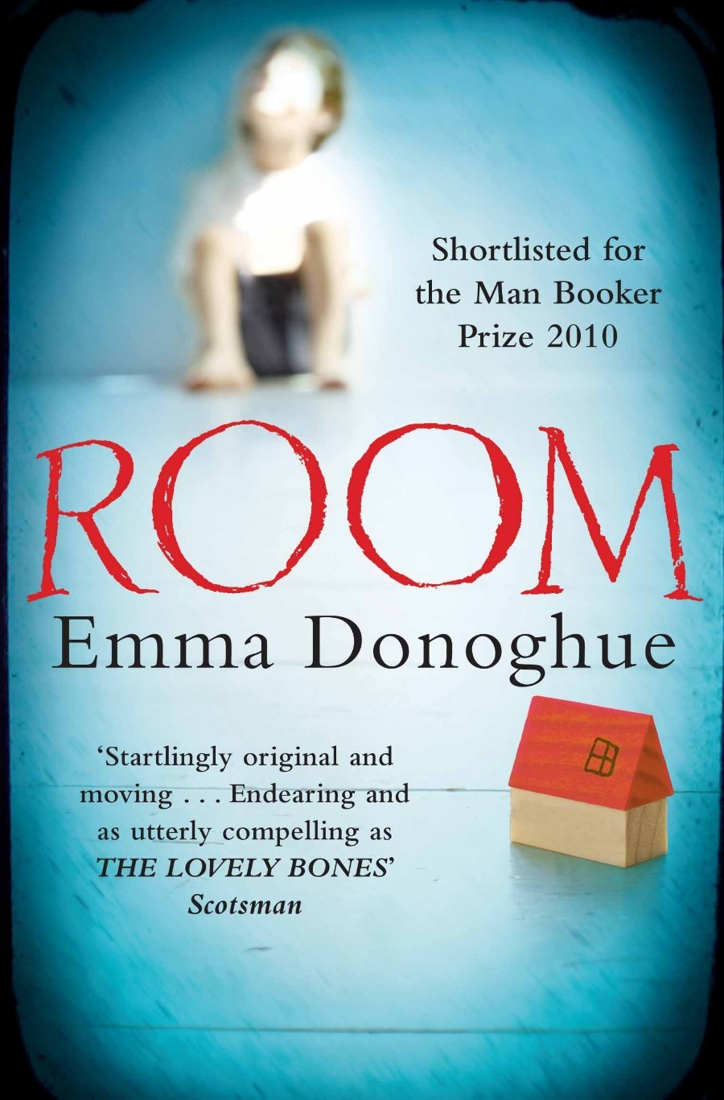

Slide 4
Ideas & Themes
Childhood
Motherhood
Womb
Outside world
  Safety versus freedom
Hell
Perspective
Imagination
Animism/Personification
Nature versus nurture

Slide 5
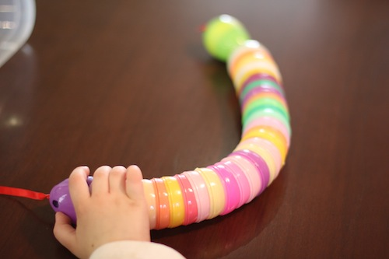

Slide 6
Childhood
“For me Room is a universal story of parenthood and childhood…”
Of course Room, as a story told from a child’s perspective, is rife with images and stories of childhood. Room is less about Ma and Jack’s captivity and more about Ma and Jack’s relationship, and Jack’s efforts to create and navigate his world, internal and external, inside and outside Room.
One of the most poignant passages in Room is when Ma is trying to tell Jack about her childhood and her (their) family (pages 82-84). Jack, only ever knowing Room, is not getting it. He doesn’t believe his mom has ever been outside. Can you imagine a childhood without outside and family?

Slide 7
Motherhood
“The narrative of motherhood is always going to be a bit sacrificial.”
In Room, Ma has to be (or create) Jack’s whole world. That is a huge task. Being a mother is already challenging enough-- Can you imagine having to be everything for your child, their only human contact?
“Really I wrote this novel because I found parenthood such a shock.”
  Donoghue talks about the isolation and suffocation mothers can experience.
  I (as a foster and step mother), and perhaps every mother can attest to these feelings. If a mother doesn’t have a support system--and is left to care for a child by herself-- it can be overwhelming and make one feel trapped.
But Donoghue notes the magical elements—”Sometimes it can feel like you’re in a magical cocoon together…”

Slide 8
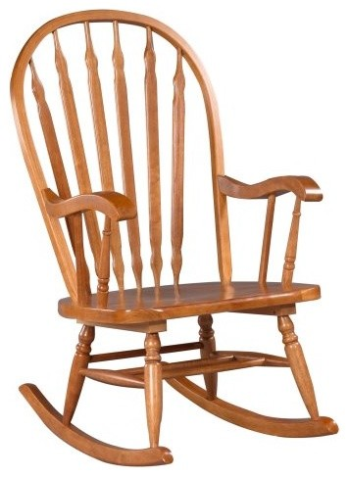

Slide 9
Womb
In Room Ma and Jack are in a world of their own. The room, at 11x11, almost seems womb-like, and Ma and Jack, at times, seem almost like twins–two children locked together (because of their lack of autonomy perhaps)--or even two parts of a whole.
"I wanted to almost think of them as a tribe of two," Donoghue explains.
"What Jack discovers early on — which is a complete shock to him — is that Room is not all there is. He's spent five years thinking that he's in this world with his mother, and that outside there's outer space with stars and planets zooming around.“ --Donoghue tells NPR's Melissa Block
http://www.npr.org/2010/09/27/130143360/in-donoghue-s-room-a-child-s-world-of-his-own

Slide 10
Outside World
“safety versus freedom”
“There are moments as a parent, Donoghue says, when you simply cannot bear to tell your children the ‘cruel truth of the world’ — and Ma is a ‘concentrated version’ of that. She does not want Jack to grow up thinking that he's a prisoner — and yet to keep that information from him is a betrayal. She has lied to him his whole life.”
Ma lied to Jack for his protection—mental and physical. I suppose but the time Jack reached 5, Me a decided that he was getting too old to accept and believe the lies. Plus how could Room sustain 2 people—one a growing boy? How much longer would their captor put up with Jack…and Ma? Ma had to make a decision. The issue of safety versus freedom is played out on many levels in Room, especially in regards to the outside world.

Slide 11
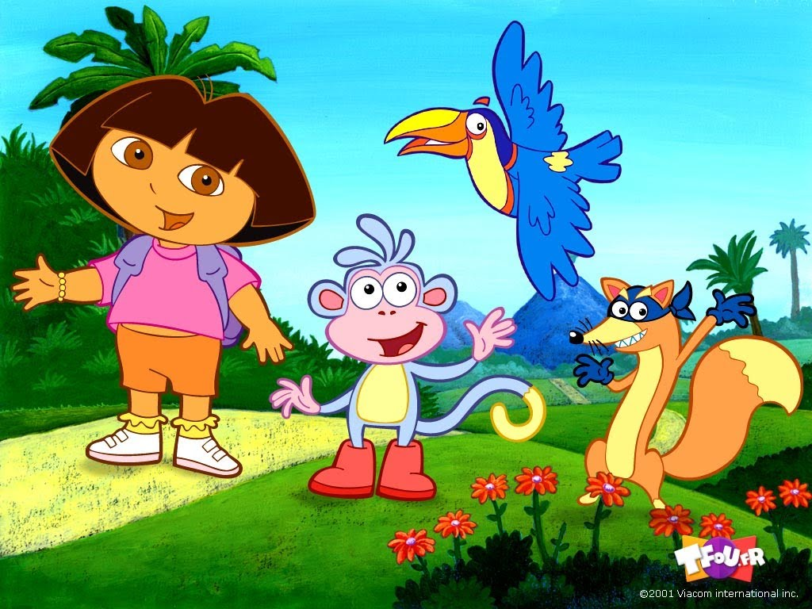

Slide 12
Hell
“descent into the abyss” is how Emma Donoghue describes Ma and Jack’s captivity.
Ma and Jack are held captive by ‘Old Nick’.
  There is chilling exchange between Old Nick and Ma on page 36 where he wants a piece of cake and gets upset because Ma is not forthcoming with it. Old Nick says to Ma, “…you’re the boss” and “I’m just the grocery boy….” trying to make her feel sorry for him!
Old Nick is another name for the devil
  “An informal name for the Devil.”
    http://www.oxforddictionaries.com/us/definition/american_english/Old-Nick
Ma and Jack experience aspects of hell in Room and on the outside. In fact outside is completely overwhelming to them, especially at first. Poor Jack, never knowing anything else, longs to go back to Room. Ma never wants to go back. This seems to be their own special hell created by Old Nick.

Slide 13

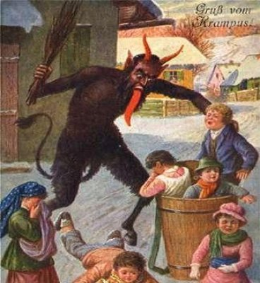

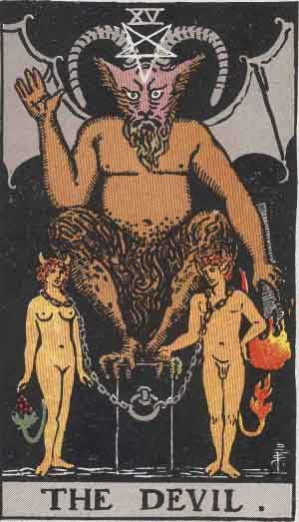

Slide 14
Perspective
“His [Jack’s] perception and idiom have been used to challenge readers to view the world from an innocent, sheltered, uniquely fresh perspective.” (Sharma 144)
Room gives readers a peak into the mind of a captive child. The perspective Donoghue chose to narrate this story from, Jack’s perspective, does animate this novel. If the story had been told from Ma’s perspective it would be much darker, much more complex and heavy. It would be more of a victim’s tale and perhaps the transformative nature of the story and the themes at work within would be lost.
“I never considered any other perspective: letting Jack tell this story WAS my idea in a nutshell. I hoped having a small child narrator would make such a horrifying premise original, involving, but also more bearable: his innocence would at least partly shield the reader on their descent into the abyss.” (Donoghue)

Slide 15
Imagination
Ma has quite the imagination, she has to in order to educate Jack and keep him busy. Of course Jack has a great imagination also. He creates his own friends and games, his own explanations of his world.
  “Extremely sensitive toward his needs, Ma has created lively regimen of exercise, singing and reading for Jack.” (Sharma 144)
  “Ma is the best, most vital, energetic, intelligent, and creative mother I could imagine.” (Donoghue)
In Room, Donoghue beautifully illustrates the transformative power of imagination. How long could Ma have lasted in captivity without imagination? How far could Jack have gotten without it?

Slide 16
Nature versus nurture
“…but then I thought of all the ways in which Jack’s limited experience has shaped him. So I sat there doing a constant nature-versus-nurture debate in my head.” (Donoghue 2)
How much does experience and environment shape a child? How much does biology and heredity?

Slide 17
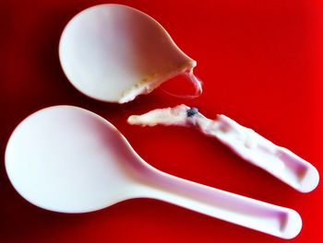

Slide 18
Animism
“The attribution of a soul to plants, inanimate objects, and natural phenomena.”
  http://www.oxforddictionaries.com/us/definition/american_english/animism
Psychology and animism
“Animism in the broadest sense, i.e., thinking of objects as animate, and treating them as if they were animate, is near-universal. Jean Piaget applied the term in reference to an implicit understanding of the world in a child's mind which assumes that all events are the product of intention or consciousness. Piaget explains this with a cognitive inability to distinguish the external world from one's internal world.”
  http://en.wikipedia.org/wiki/Animism#Psychology_and_animism

Slide 19
Personification
Animism is related to personification, though animism can be thought of as a belief system and personification as the action itself (or a literary device ☺ )
“Personification is the act of giving what we consider human-like traits to animals or non-living things. Its not a belief in and of itself however anthropologists and psychologist looking at animism may consider it a spiritual kind of personification of the natural world.”
  https://answers.yahoo.com/question/index?qid=20111214152525AAz3xK5
Young Children's Thinking about Biological World
By Giyoo Hatano, Kayoko Inagaki
  http://books.google.com/books?id=8ryxklUSlB0C&pg=PA44&lpg=PA44&dq=personification+and+animism&source=bl&ots=JWo9yQ0K0a&sig=BE0ZmW9G648zxQF7vyG6IhbjfMQ&hl=en&sa=X&ei=0IpFU-7aIKaIygHtjIGoDQ&ved=0CEcQ6AEwBQ#v=onepage&q=personification%20and%20animism&f=false

Slide 20


Slide 21
Context
Overall, as Donoghue has said herself, Room is about the parent-child bond, the parent-child relationship. In Room, Donoghue illustrates the isolation of motherhood. She explores the dynamics of the parent-child relationship– how it can be too close sometimes yet how that closeness can be beautiful and beneficial to both parents and children (within moderation, of course– not in captivity).
Room is also about letting go– Donoghue has said that she wrote the novel as almost “a meditation on safety versus freedom”– do you keep your child close or let them have freedom? When do you let them go? When do you keep them close? It is a constant debate.
I would say that Room is all about a mother’s love and what she will do for her child, even one born of rape.

Slide 22
Context
Donoghue has also said that Room is a study of family and how society tends to sentimentalize family relationships. She wanted to show a family, a parent-child relationship that would get away from sentimentalizing those relationships – to show real family dynamics. Real families aren’t perfect, they have issues and squabbles; real parents (and children) need space. We live in a the real world after all, not a fairytale world, or Room of our own.
  Donoghue uses the break-up of Ma’s parent’s marriage and Ma’s father’s attitude toward Jack to show how a family can be fractured by a traumatic event.
  At times, Jack’s grandma has issues adapting to Jack.

Slide 23
Context
“Donoghue strategically employs relationship between mother and child, family and loss, violence and power to demonstrate her grit to preserve innocence against all odds. Forced to live in a world comprising lifeless objects, Donoghue operates through the voice of the innocent narrator to evoke narrative empathy in the reader to trigger transformation deep within.” (Sharma 144)
Jack makes a compelling narrator. He has his hero’s journey in the story, but both he and Ma are heros.
Of course Room is abut the transformative power of imagination and perspective. Room for Jack was his world, and a place he felt safe because his mother made it so. Room for Ma was hell. But of course the outside world can be hell too. I think Donoghue illustrates that through imagination and love, people can adapt to, and overcome anything.

Slide 24
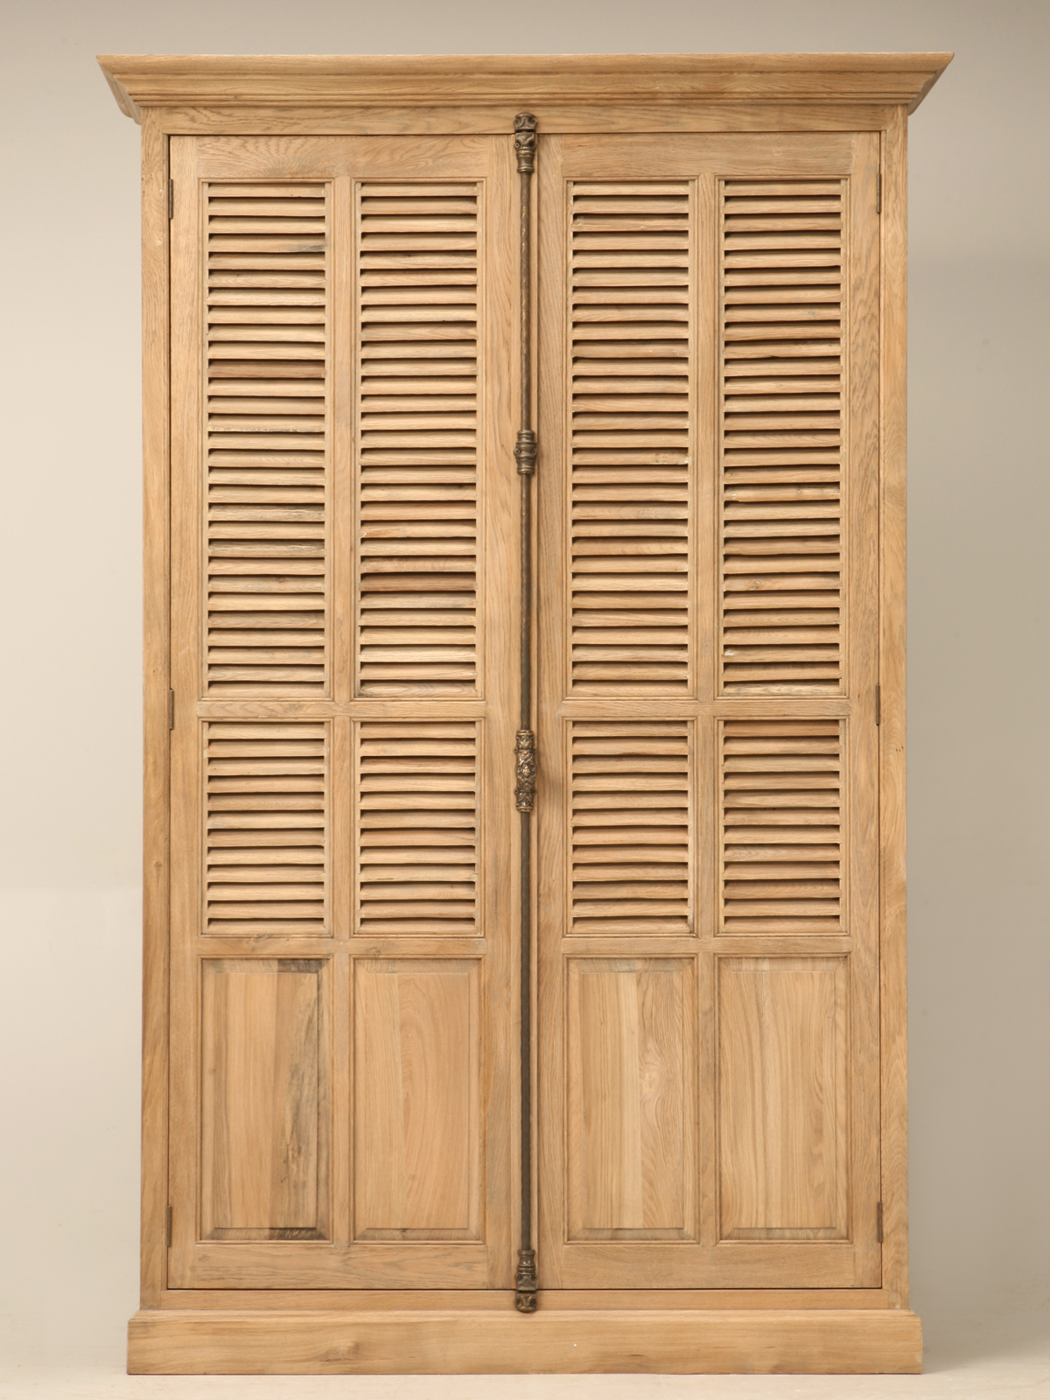

Slide 25
Praise for Emma Donoghue and Room
“The Irish-born Donoghue has written eccentric, otherworldly stories before ("Slammerkin" is probably her best known), but "Room" -- shortlisted for the Booker Prizelast week -- should appeal to an even larger audience. Not too cute, not too weirdly precocious, not a fey mouthpiece for the author's profundities, Jack expresses a poignant mixture of wisdom, love and naivete that will make you ache to save him -- whatever that would mean: Delivering him to the outside world? Keeping him preserved here forever?” –Ron Charles, The Washington Post
“On the whole, Donoghue goes the distance with “Room,” and she brings her story to a powerful close that feels exactly right. This is a truly memorable novel, one that can be read through myriad lenses — psychological, sociological, political. It presents an utterly unique way to talk about love, all the while giving us a fresh, expansive eye on the world in which we live.”—Aimee Bender, The New York Times

Slide 26
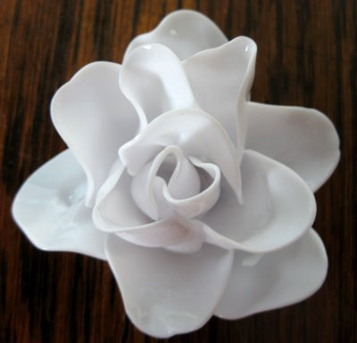

Slide 27
Source Links
(Not otherwise noted)
http://www.youtube.com/watch?v=sOlJIV-UdFM&feature=fvst
http://www.youtube.com/watch?v=WCVBlEZs9ug
http://moreintelligentlife.com/blog/molly-young/qa-emma-donoghue
http://www.washingtonpost.com/wp-dyn/content/article/2010/09/14/AR2010091406235.html
http://www.nytimes.com/2010/09/19/books/review/Bender-t.html?pagewanted=all&_r=3&
http://thelabyrinthjournal.com/pdfs/Labyrinth%20ISSN%200976-0814%20Vol.4%20No.3.pdf
  Sharma, Khem Raj. “Narratological Complexities in Emma Donoghue’s Room.” Labyrinth: An International Refereed Journal of Postmodern Studies. July 2013: 4, 3. Web.

Slide 28
Image Links
Snake--http://www.vidalicious.com/crafty/egg-snake-project/
Rocker--http://www.houzz.com/photos/919094/Hudson-Bow-Back-Rocking-Chair-traditional-rocking-chairs-
Dora--http://www.youtube.com/watch?v=WhZFNH_A1qA
Old Nick/Devil--http://en.wikipedia.org/wiki/The_Devil_(Tarot_card)
  http://doubleportioninheritance.blogspot.com/2011/11/santa-claus-or-satan-claws.html
  http://www.thefreedictionary.com/Old+Nick
Spoons--http://www.alienspouse.com/jen_weblog/2011/02/with-the-exciting-aroma-of-melting-plastic.html
Jeep--http://www.aliexpress.com/item/Oversized-drift-remote-control-car-remote-control-car-toy-car-charge-toy-car-remote-control-automobile/1594544503.html
Wardrobe--http://www.productwiki.com/awesome-louvered-solid-weathered-oak-armoire/
Spoon Flower--http://www.cantstopmakingthings.com/2010/04/rose-is-rose.html

